Slide 1
AHA Health Plan Accountability and Ongoing Advocacy
American Association of Healthcare Administrative Management
April 15, 2025
Terrence Cunningham Senior Director, Administrative Simplification Policy

Slide 2
Overview
Prior Authorization Overview and Need for Reform
Legislative and Regulatory Landscape
Proposed Bill – Highlights
Proposed Bill – Potential Improvements
Wrap-up/Questions
1

Slide 3
Prior Authorization: Overview and Need for Reform

Slide 4
Current Problems with Prior Authorization
Patient Impact:
Disruption and delays in patient care
Denials of appropriate and necessary care
Administrative burdens caused by health insurer’s protocol:
Inefficient submission methods
Lack of transparency on required documentation and medical necessity criteria

Slide 5
Prior Authorization: Delays and Disruptions in Care
Patient Experience: 16% of all insured adults report an problem accessing needed care as a result of prior authorization. (KFF Survey, 2023)
Impact on care and health outcomes (AMA Survey, 2024):
93% of physicians report delays in care
82% report patient abandonment
29% report serious adverse event
Post-acute Care Issues (U.S. Senate Report)
Substantially higher denial, overturn rates for these services

Slide 6
Prior Authorization: Denials of appropriate care
2022 HHS-OIG Report:
13% of prior authorizations (and 18% of claims) were denied despite satisfying medical necessity requirements and being consistent with care guidelines
2018 HHS-OIG Report:
75% of all prior authorizations that are appealed are overturned

Slide 7
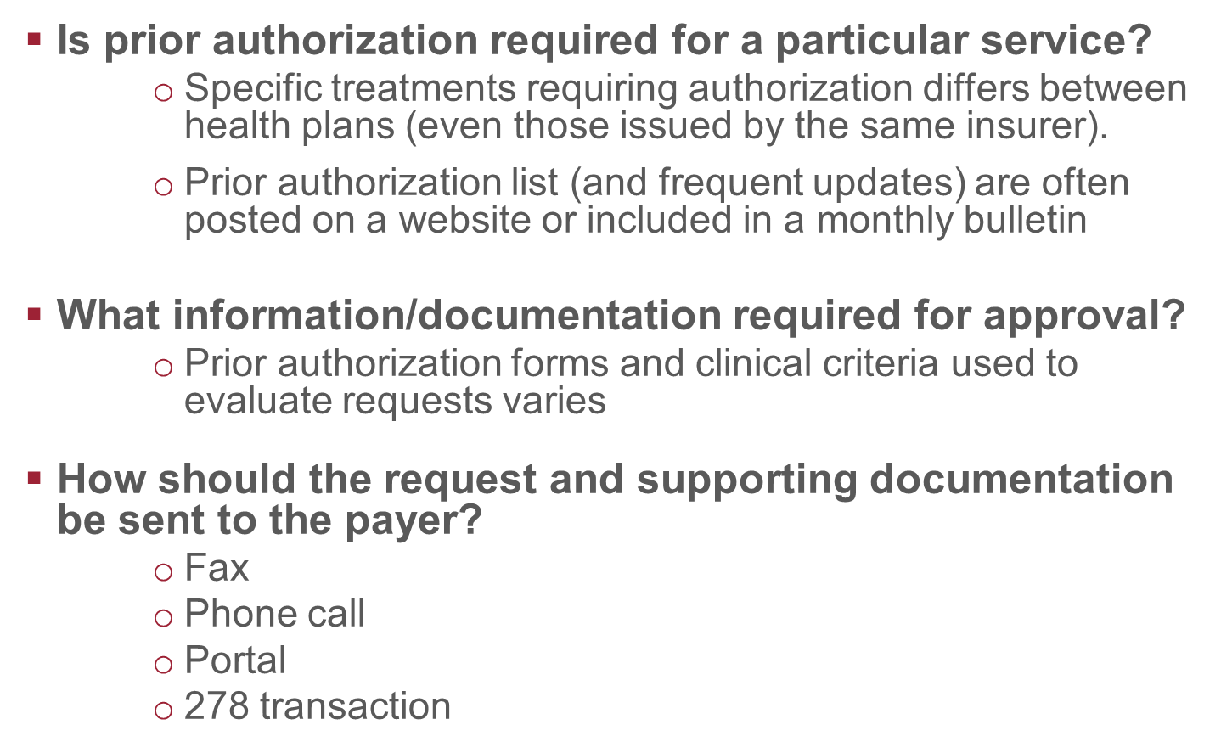
Differences in insurer requirements and submission methods

Slide 8
Legislative and Regulatory Landscape

Slide 9
Federal Regulations
Interoperability and Prior Authorizations Rule (CMS-0057-F):
Standard transaction (HL7 FHIR APIs)
Shorter timeframes: 72 hours urgent requests, 7 days standard requests
Reporting Metrics: Creates reporting metrics to allow greater tracking and identification of problematic plans to potentially enable greater accountability.
Require plans to include specific, detailed reasoning for prior authorization denials
CMS Medicare Advantage Requirements
Medical Necessity Criteria
Transparency
Clinical validity
Reviewer credentials

Slide 10
Proposed Model Bill

Slide 11
NCOIL Model Prior Authorization Bill
Disclosure and Validity of Prior Authorization Requirements
Complete list of all services for which PA is required
Transparency of medical necessity criteria
Evidence-based, nationally recognized, patient-flexible criteria.
60-day notice of new requirements
Time-restrictions
7 days standard requests, 48 hours urgent requests
Denial Specifics: Detailed explanation and appeal information
Revocation Restrictions:
Continuity of Care
Enforcement

Slide 12
Model Prior Authorization Bill: Improvement Recommendations
Electronic Standard: Recommend mirroring federal requirements (plans and providers will already be using the HL7 standard)
Post-acute Care: Classify all post-acute prior authorizations as urgent
Reporting Requirements: Aggregate data instead of service-specific data
Reviewer Credentials: Recommend applying to all denials, not just appeals
Insurer Review of Requirements: recommend stronger language (periodically review and consider removal)
Length of Approvals: Recommend 1 year rather than 6 months

Slide 13
Key Take-Aways
Prior Authorization is ripe for reform
Required revisions are consistent with other plan requirements
Model bill will substantially improve patient care and administrative burden and costs
AHA stands ready to work with the committee to ensure bill achieves optimal care improvement

Slide 14
Contact / Questions
Terry Cunningham
Senior Director, Administrative Simplification Policy
American Hospital Association
tcunningham@aha.org

