Slide 1
The Federal Home Loan Bank system and insurance company insolvency

Slide 2
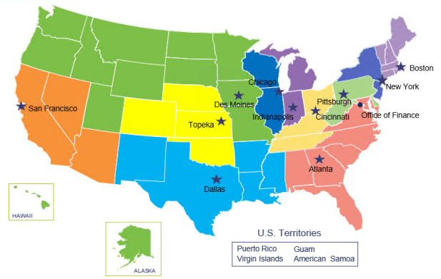
Federal Home Loan Bank Overview
11 regional FHLBanks
A Government Sponsored Enterprise (GSE)
Regulator: Federal Housing Finance Agency
We make loans to approx. 6,700 insurance companies, banks and credit unions
Operations funded through the sale of debt
Global investors buy our notes and bonds
Moody’s Aaa and P-1; S&P AA+ and A-1+
No taxpayer funding; never a bailout

Slide 3
Federal Home Loan Bank Overview cont’
Each FHLBank is a cooperative
Membership is voluntary
Members purchase par-value stock
We pay quarterly dividends to members
Fund grant programs with 10% of earnings
Approx. $5 billion since 1990
FHLBanks are secured creditors
Loans that are fully collateralized
Required by our regulator
Allows us to lend at low rates

Slide 4
Systemwide Lending by Year (in Billions)

Slide 5
Systemwide Insurance Company Membership by Year

Slide 6
Systemwide Insurance Company Lending by Year (in Billions)

Slide 7
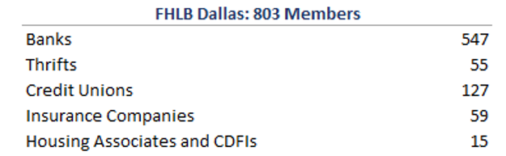
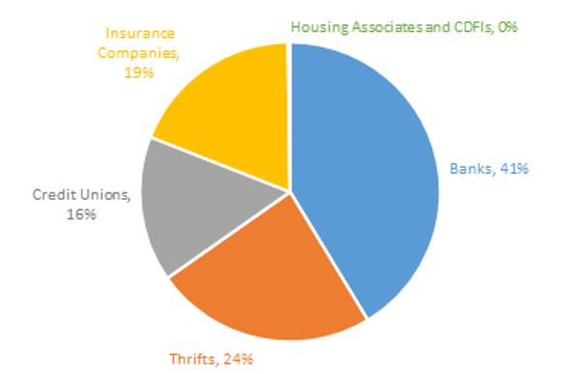
FHLBank Dallas Membership by Charter Type

Slide 8
Need for Legislation
For banks and credit unions, FHLBanks have statutory lien priority
Ensures our access to collateral without delay
But state-regulated insurance is different
In a receivership:
Federal law might not apply to FHLBank access to insurance company collateral, resulting in delays
To compensate, we require additional collateral in states that don’t permit FHLBank access to collateral
FHLBank legislation amends state law to:
Clarify that a receiver shall not deny or delay the FHLBank from accessing insurance company collateral, and
Create a framework for a receiver and FHLBank to work together in a receivership
Result: FHLBanks can lend to insurers on more favorable collateral terms

Slide 9
Collateral Values Are Lower for Insurance Companies
 | Banks |  |  |  | Insurance Companies
U.S. Treasuries | <5 years | 5-10 | 10-20 |  | <5 years | 5-10 | 10-20
Bills | 2% |  |  |  | 2%
Notes | 2% | 3% |  |  | 2% | 6%
Bonds | 2% | 3% | 4% |  | 5% | 7% | 8%
Strips | 6% | 7% | 8% |  | 7% | 8% | 9%

Slide 10
Summary of FHLB Legislative Proposal
The Framework:
Within 10 days, the FHLBank shall provide a timeline and process for:
Releasing excess collateral, the payment of fees, unwinding of safekeeping accounts, and the redemption of FHLBank stock
The FHLBank shall provide options regarding renewing or restructuring advances.
FHLB Collateral Access Assurance:
10th day of receivership: A receiver will not stay an FHLBank from exercising its rights regarding collateral.
The receiver may not void or repudiate ordinary transactions that comply with applicable laws, regulations, and agreements.
Voidable preferences and fraudulent transactions would only apply to intentional bad faith acts.
Receiver's Access to Excess Stock:
If FHLBank access to collateral results in excess FHLBank stock, the Bank will redeem such excess stock.

Slide 11
Definition: Preference
A tool a receiver can use to recapture payments made by the debtor to creditors directly before a receivership proceeding begins. Generally, for a receiver to recapture preference payments, the payments must have been made within a set period of time, usually somewhere between 90-180 days prior to the start of a receivership and be in excess of what the creditor would have received in a liquidation action. Intended to prevent the debtor from favoring one creditor over another.

Slide 12
Definition: Fraudulent Transfer
Generally, two types of fraudulent conveyances. The first, actual fraud, involves debtors' intent to defraud creditors. The second, constructive fraud, involves a transfer that is made in exchange for grossly inadequate consideration. For both types of fraudulent transfers there is generally a “look back period” usually one or two-years. Thus, to be considered a fraudulent transfer, the transfer must occur within one or two years immediately before a receivership filing.

Slide 13
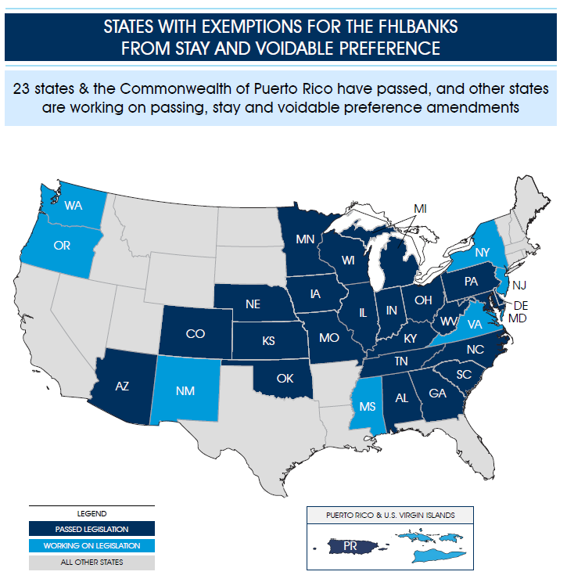

Slide 14
Questions

